Slide 1

Session 29: Domain Name Dispute Resolution
NJA Advanced Course on Commercial Matters
Bhopal, India
January 23, 2016
Richard Tan, Chartered Arbitrator, Singapore

Slide 2
The Uniform Domain Name Dispute Resolution Policy (UDRP)
2
WIPO initiated and administered since 1999
  First WIPO Report
Trademark-based, for addressing cybersquatting
  curative mechanism for abusive registration and use
Expedient alternative to court litigation
  court options preserved
Principal advantages:
  Efficient – time and cost effective
  Predictable – proven system for clear cases
  International – enforceable across jurisdictions
Notes:
2

Slide 3
The “U” in UDRP
3
Applicable across all generic top level domain (gTLD) registrations (.com, .org, .net, etc.)
  New gTLDs
Via harmonized contract structure
  between domain name registrant and registrar (registration agreement)
  between registrar and ICANN (registrar accreditation agreement)
Many ccTLD registries have also elected to adopt the UDRP (mutatis mutandis) (e.g., .ro, .tv) or variant based on it (e.g., .au)
Notes:
3

Slide 4
UDRP Standing, Remedies and
Published Decisions
4
Standing – based on trademark rights
Remedies straightforward – transfer or cancellation
  no costs or damages
  declaratory relief against any abusive complaints
WIPO Center administers procedure, independent WIPO panel decides merits, reasoned panel decision issued
Notes:
4

Slide 5
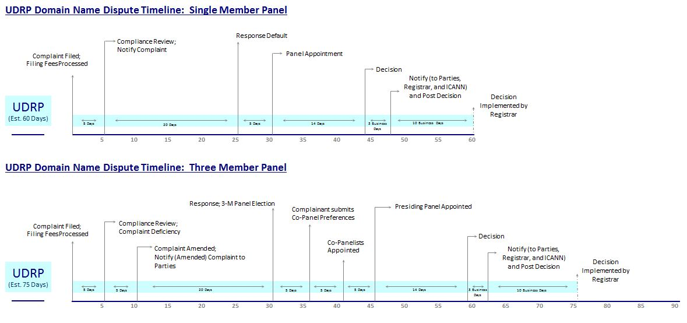
UDRP Process
7 to 10 clear steps, 60 to 75 days

Slide 6
UDRP Key Design Elements
International, contract-based
Simple, linear process
Non-exclusive safe-harbors for registrants
Non-exclusive concept of bad faith (legal flexibility)
Independent administrative panel
Simple remedies, directly enforced through registrar
  Without going to court while retaining court options

Slide 7
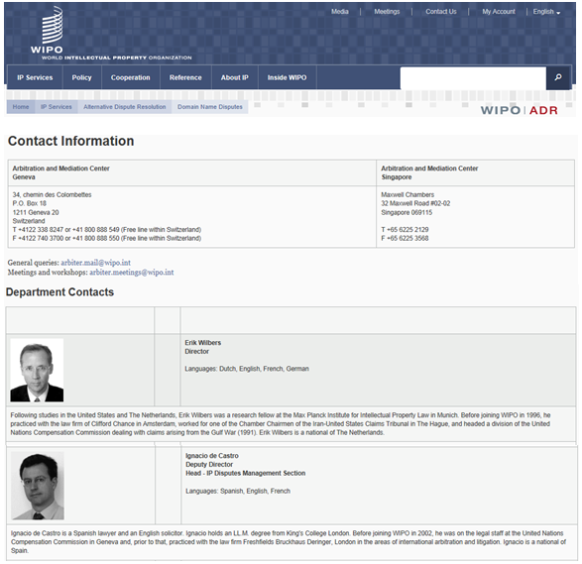
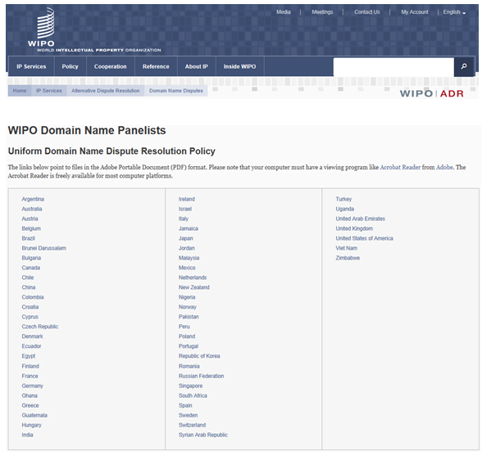
WIPO as UDRP Provider
WIPO Center Staff
24 nationalities, 26 languages
Senior Legal Staff / Case Managers
Case Secretariat
IT Support
WIPO Panelists
WIPO Domain Name Panel Roster
Some 500 publicly-listed experts
Drawn from 57 countries, across
all continents

Slide 8
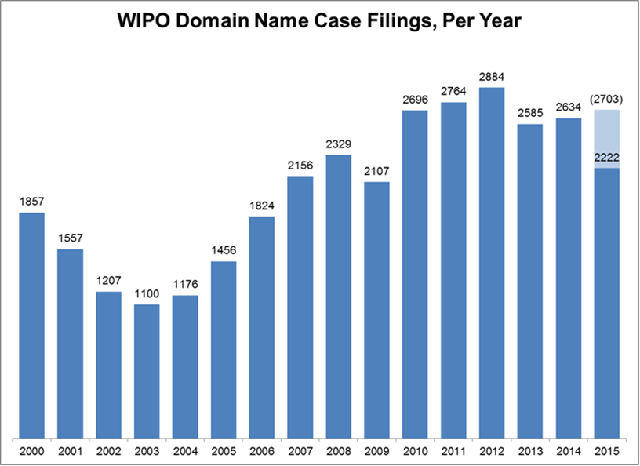
WIPO Filing Trends Over Time
Average of 10 new cases per working day in 2015
*Reflects total domain name cases filed as at end of October 2015

Slide 9
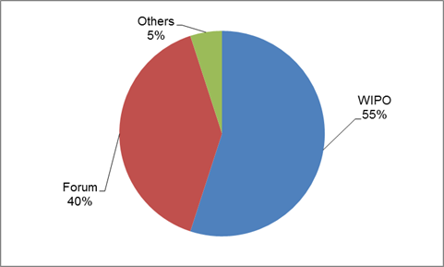
UDRP Cases Across All Providers

Slide 10
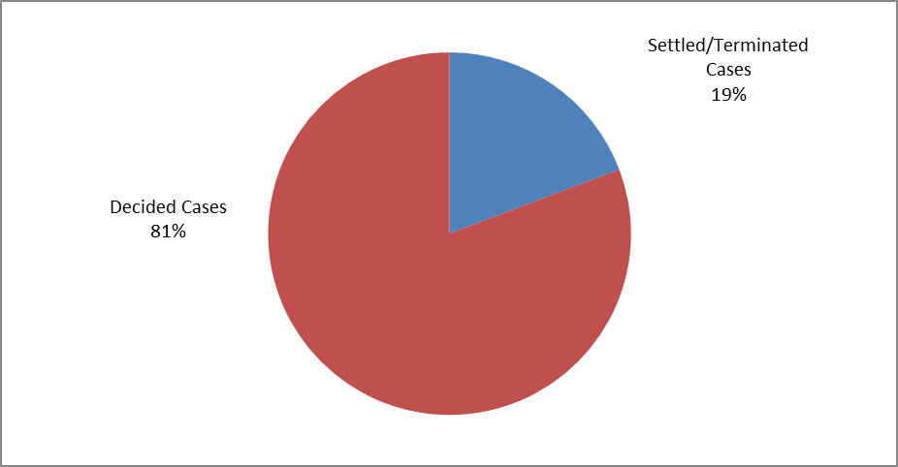
WIPO Party Settlement / Termination
*19% of cases settled / terminated at WIPO in 2015
Notes:
19% of WIPO cases are concluded through Party Settlement or Termination. This is an interesting rate, as unlike other dispute resolution providers, WIPO Center refunds the panel fee part of the filing fees in case of settlement and termination prior to panel appointment. Since 2000, WIPO refunded some 5 million USD to settling parties.

Slide 11
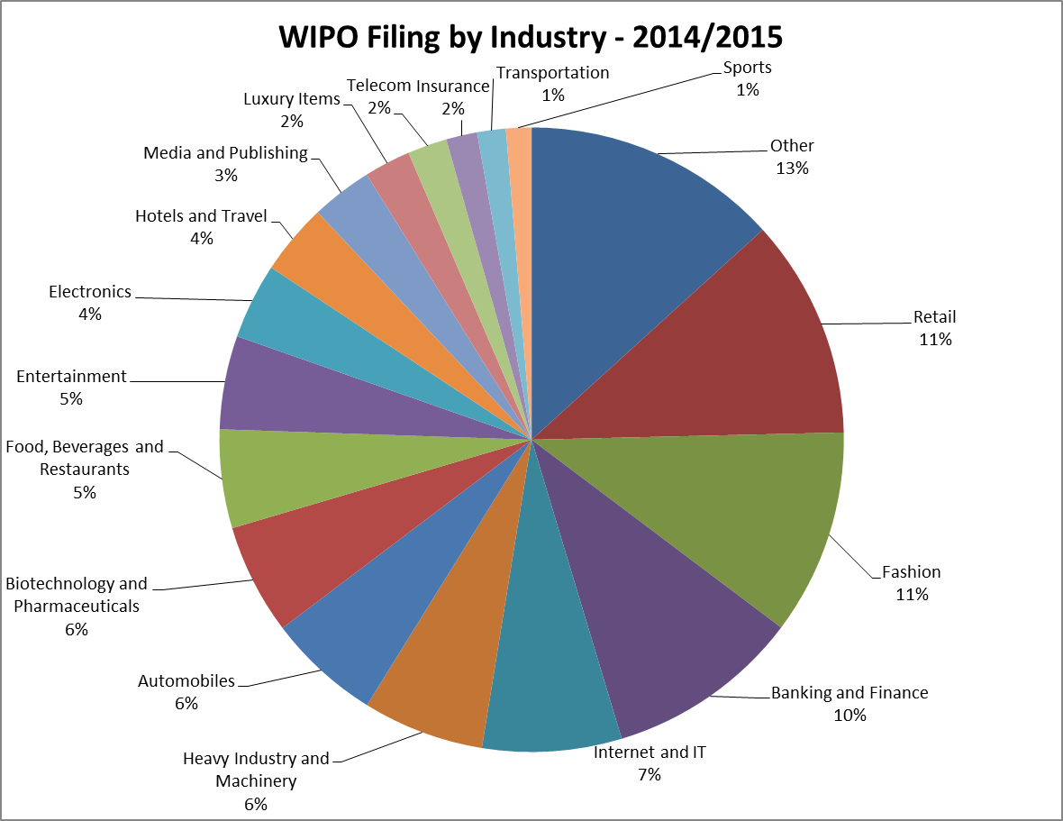
WIPO Filing by Industry – 2014-2015
Notes:
Top 3 filers of all years are Retail, Fashion, and Banking and Finance. The past year the Top 3 industry sectors are the same, as indicated in the pie: this reflects what we have seen as recent trend, i.e. that counterfeit and phishing activities are increasing.

Slide 12
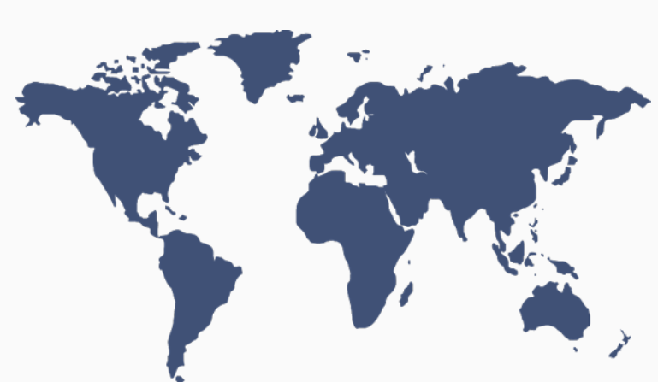
WIPO Parties from 107 Countries
November 2014 through October 2015
Notes:
Parties to DN disputes came from 107 countries this past year. WIPO Parties from 177 Countries All Years. Global aspect of DN disputes!

Slide 13
Top 10 WIPO Complainant Country Filing
All Years
November 1, 2014 to October 20, 2015
Complainant Country | Number of Cases | Percentage of Cases
United States of America | 12004 | 36.95%
France | 3643 | 11.21%
United Kingdom | 2569 | 7.91%
Germany | 2050 | 6.31%
Switzerland | 1758 | 5.41%
Italy | 1182 | 3.64%
Spain | 1142 | 3.51%
Denmark | 1025 | 3.15%
Netherlands | 908 | 2.79%
Sweden | 673 | 2.07%
Complainant Country | Number of Cases | Percentage of Cases
United States of America | 780 | 30.27%
France | 307 | 11.91%
Germany | 247 | 9.58%
United Kingdom | 210 | 8.15%
Switzerland | 156 | 6.05%
Netherlands | 91 | 3.53%
Italy | 81 | 3.14%
Denmark | 75 | 2.91%
Sweden | 68 | 2.64%
Spain | 61 | 2.37%
Notes:
Simply note that this past year, the top 2 Complainant Countries have remained the same, namely: USA and France, but United Kingdom has been overcome by Germany, maybe related to Fashion (Jack Wolfskin, HUGO BOSS, icberlin), Car Manufacturers (bmw, Audi, Volkswagen, Porsche) and Pharmaceuticals/Chemical (Boehringer Ingehlheim, BASF)?

Slide 14
Top 10 WIPO Respondent Country Filing
All Years
November 1, 2014 to October 20, 2015
Respondent Country | Number of Cases | Percentage of Cases
United States of America | 10635 | 32.73%
China | 3251 | 10.01%
United Kingdom | 2533 | 7.8%
Spain | 1229 | 3.78%
Canada | 1113 | 3.43%
Australia | 1102 | 3.39%
France | 983 | 3.03%
Republic of Korea | 932 | 2.87%
Netherlands | 835 | 2.57%
India | 619 | 1.91%
Respondent Country | Number of Cases | Percentage of Cases
United States of America | 595 | 23.09%
China | 375 | 14.55%
United Kingdom | 194 | 7.53%
Australia | 113 | 4.38%
Netherlands | 88 | 3.41%
France | 84 | 3.26%
India | 84 | 3.26%
Turkey | 79 | 3.07%
Spain | 69 | 2.68%
Republic of Korea | 53 | 2.06%
Notes:
Worth noting that this past year, the Top 3 Respondent Countries have remained the same as usual, namely: USA, China, and UK.
Australia is currently at the 4th place, as Respondents frequently use a Privacy Shield Service that is located in Australia.

Slide 15
WIPO Languages of Proceedings
All Years
2014-2015
Case Language | Number of Cases | Percentage of Cases
English | 28620 | 88.09%
Spanish | 1323 | 4.07%
French | 816 | 2.51%
German | 391 | 1.2%
Dutch | 360 | 1.11%
Chinese | 354 | 1.09%
Korean | 273 | 0.84%
Portuguese | 108 | 0.33%
Turkish | 83 | 0.26%
Italian | 50 | 0.15%
Romanian | 37 | 0.11%
Japanese | 36 | 0.11%
Russian | 17 | 0.05%
Swedish | 8 | 0.02%
Vietnamese | 4 | 0.01%
Danish | 3 | 0.01%
Polish | 2 | 0.01%
Slovak | 2 | 0.01%
Czech | 1 | 0.0%
Hebrew | 1 | 0.0%
Norwegian | 1 | 0.0%
Case Language | Number of Cases | Percentage of Cases
English | 4114 | 85.85%
Spanish | 194 | 4.05%
Chinese | 115 | 2.40%
French | 112 | 2.34%
Dutch | 77 | 1.61%
German | 53 | 1.11%
Portuguese | 40 | 0.83%
Turkish | 32 | 0.67%
Romanian | 17 | 0.35%
Korean | 14 | 0.29%
Japanese | 11 | 0.23%
Vietnamese | 4 | 0.08%
Italian | 3 | 0.06%
Russian | 3 | 0.06%
Swedish | 1 | 0.02%
Polish | 1 | 0.02%
Slovak | 1 | 0.02%
Notes:
WIPO Center has worked in 17 different case languages in the past year and Chinese is now the third biggest language.

Slide 16
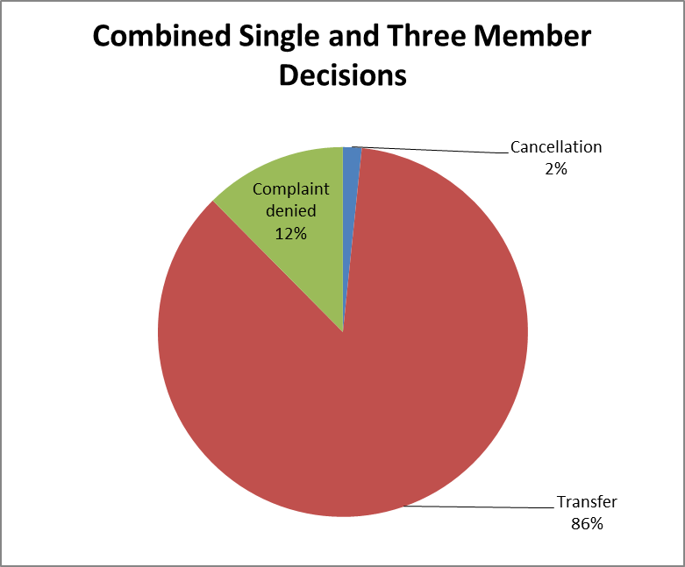
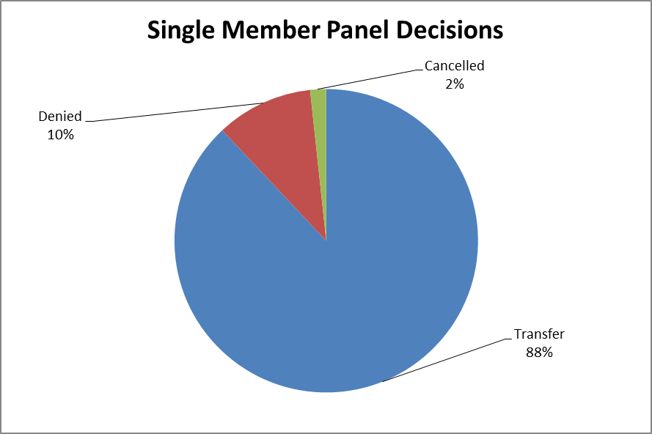
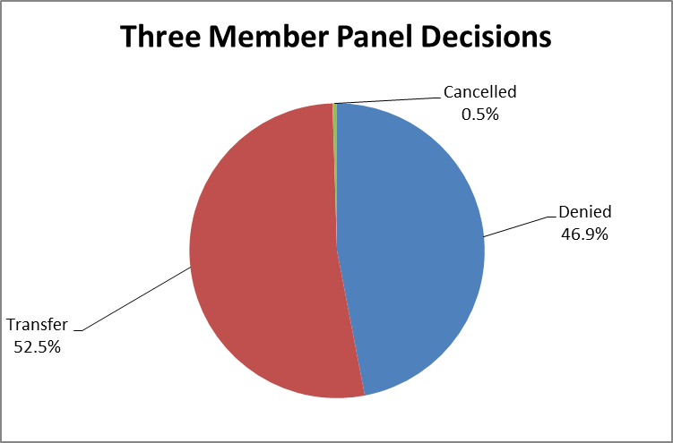
Outcome in WIPO Cases – All Years
Notes:
As we note that Transfer is overall the outcome in the majority of decisions rendered (why? Typical outcome in UDRP, a policy that aims to offer predictability for parties and solve clear-cut abusive DNs registrations), we also note a lower Transfer rate in 3MP cases.

Slide 17
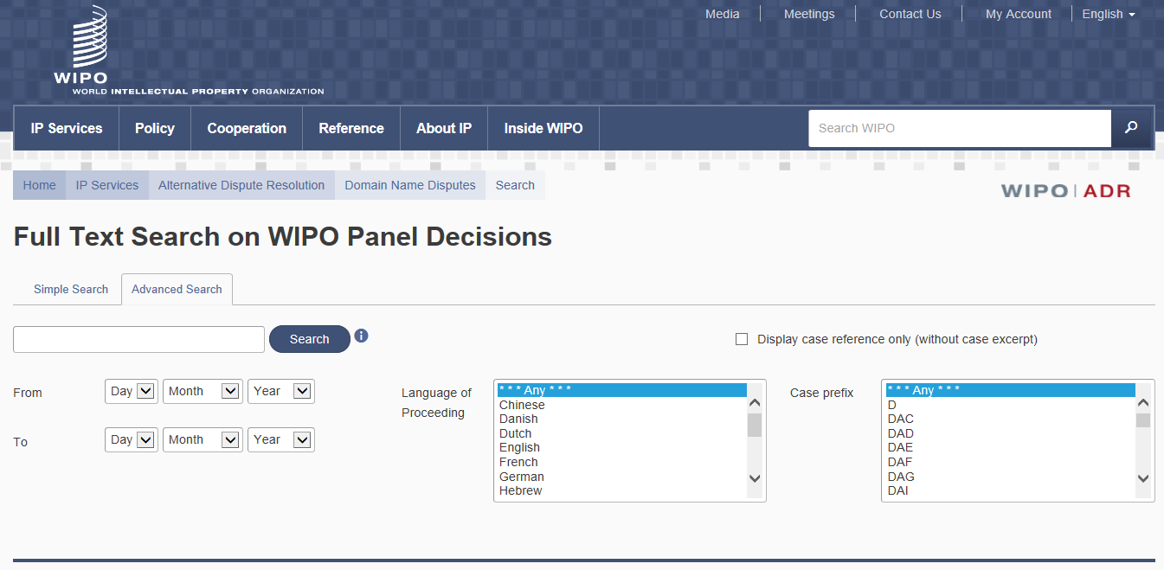
Behind the Outcomes:
UDRP Jurisprudence
  All WIPO UDRP decisions are published and fully searchable online
Public access to the large quantity of legal and other data contained therein
Though decisions are not binding as such, panels generally strive for predictability and consensus
Notes:
- Since 1999, jurisprudence has evolved through thousands of UDRP panel decisions.
- There is no rule of legal precedent in UDRP administrative decisions, however panels acknowledge the importance of predictability and consensus. It is important that similar circumstances translate into similar outcome.

Slide 18
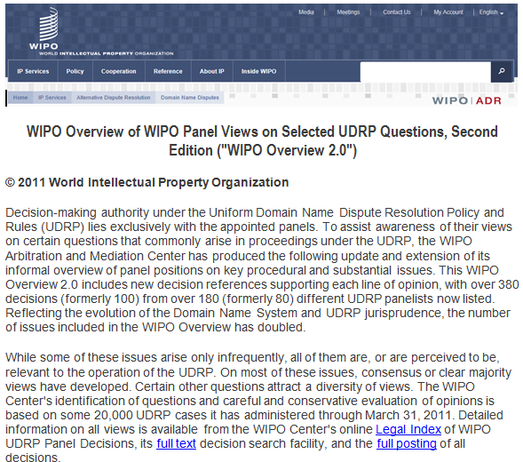
Navigating WIPO
Resources Online
WIPO Overview 2.0
  Reflects statements on some 50 substantive and procedural UDRP issues
  Draws on the thousands of cases administered by WIPO and decided by WIPO panelists
Notes:
- WIPO offers freely accessible extensive DN dispute resolution resources online.
- One of these resources is the WIPO Overview of WIPO Panel Views on Selected UDRP Questions, a Globally unique tool, distilling panel positions.
- Often party claims and Panel Decisions refer to the WIPO Overview!

Slide 19
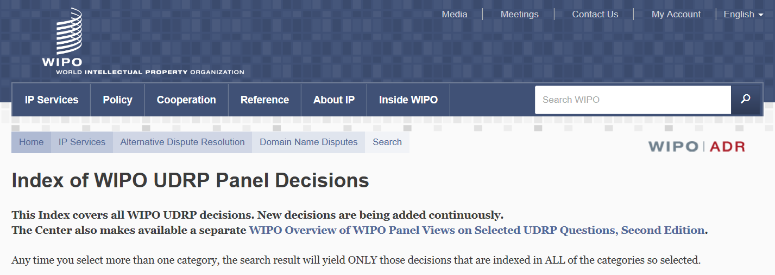
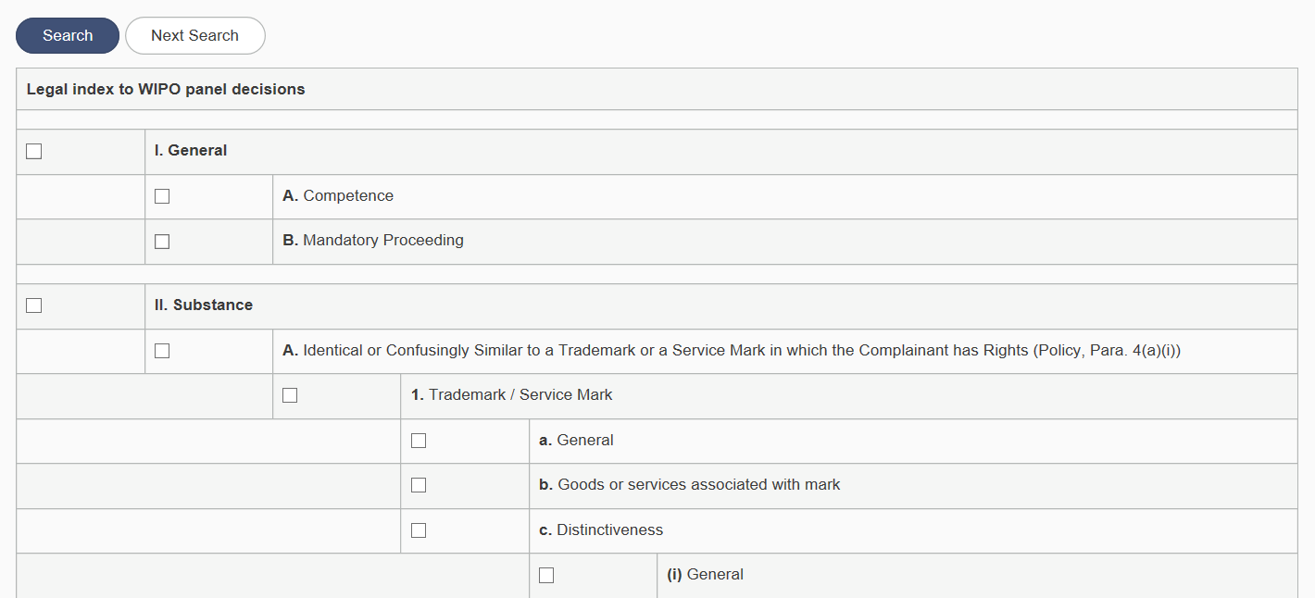
Navigating WIPO
Resources Online
WIPO Legal Index
  Allows decision research via use of some 260 research key words on substantive and procedural UDRP issues
  Draws on the thousands of cases administered by WIPO and decided by WIPO panelists
Notes:
- It is another online freely-accessible resource. The Index suggests key words to facilitate legal research on substantive and procedural issues.
- UDRP designed to be a simple, linear process, abusive registration is relatively easy to demonstrate. A panel will be convinced if you reference precedent that is to the point.
- Bottom line: use precedent and the WIPO facilities to build your case!
- Other useful resources are the Model pleadings, FAQs and general information about the UDRP online.
I thank you for your attention and wish you a very pleasant and productive continuation!

Slide 20
THANK YOU
Richard Tan, Chartered Arbitrator, Singapore
Independent Arbitrator
Consultant, Morgan Lewis Stamford
email: richard.tan@rtanarbitrators.com

